Slide 1


ARM MTE Study
Grange Nagy
Juan Trevino
Estimated Total Hours: 10-15 per person

Slide 2
Plans (Past Week)
Test uniform distribution of MTE tags
Read some past papers/articles about MTE
Explore page swap code found online
Compression of page tags?
Test distribution of tags

Slide 3
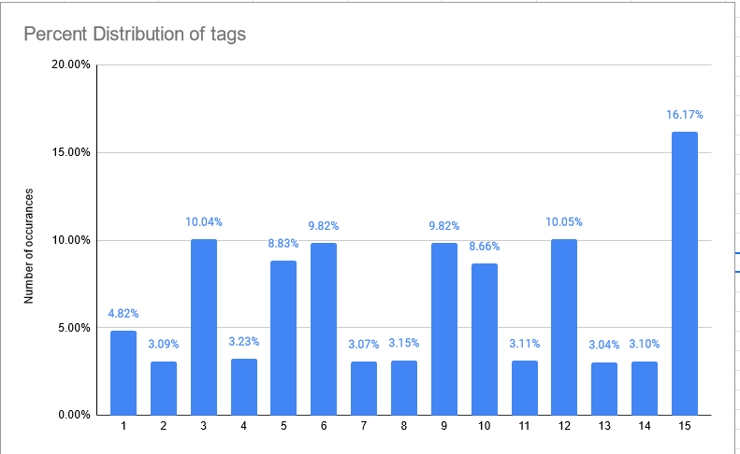
What Actually Happened
Work completed: all
Interesting points:
**Zer0con -> “Beyond Android MTE: Navigating OEM's Logic Labyrinths,” they linked previous Pwn2Own bugs to prove they can be easily applied to Samsung/Xiaomi products with MTE (Memory Tagging Extension).
Grange’s idea of reproducing old exploits was accurate
**ARM MTE Bypass using Speculative Execution
Mentions speculative probing?
Str instruction after irg before stg
The researcher also has a few papers on Cache SCA’s
2022 Bluehat security analysis essentially mentions a good amount of ways to exploit/bypass MTE
Bypasses include corrupting pointers, leveraging information disclosures to learn tags, or exploiting type confusions that MTE does not inherently mitigate
**Tags (generated via their IRG instruction) don’t necessarily have a uniform distribution, favor 3, 5, 6, 9, 10, 12, and 15 over 100M iterations.
Entropy of 3.66 vs a theoretical max of 3.91
Would we be able to make this even worse somehow? Under/overvolt? Fault injection?

Slide 4
What Actually Happened
Work completed: all
Interesting points:
A lot of the MTE code is online…
Page swap commits
“arm64: mm: support THP_SWAP on hardware with MTE” - “("arm64: enable THP_SWAP for arm64") brings up THP_SWAP on ARM64, but it doesn't enable THP_SWP on hardware with MTE as the MTE code works with the assumption tags save/restore is always handling a folio with only one page.”
**MTE Code:
Assembly: https://elixir.bootlin.com/linux/latest/source/arch/arm64/lib/mte.S#L163
Swap: https://elixir.bootlin.com/linux/latest/source/arch/arm64/mm/mteswap.c#L50
Page table mentions: https://elixir.bootlin.com/linux/latest/source/arch/arm64/include/asm/pgtable.h#L97
General functionality: https://elixir.bootlin.com/linux/latest/source/arch/arm64/kernel/mte.c#L146

Slide 5
Plans (Next Week)
Explore the code, see if we can find one trivial error/bug that can be exploited
“Map” the code to see logically what happens from tag creation/storage to swaps
Explore more documentation about where tags are stored referencing code
Explore the stack smashing from prior bypass attempts, can this be exploited somehow?
See if the Zer0con Speculative execution paper is released soon (hopefully…)

